Slide 1
HTML5 WebApps on S40
Claudio Riva etc

Slide 2
Summary
A good support for HTML5 web apps is becoming a necessity rather than a novelty on mobile devices, increasingly also for feature phones.
Our goal is to provide the best experience possible for HTML5 web apps on S40 phones.
We tackle this problem with the following approach:
Making a native port of the popular webkit browser on S40
Carefully selecting the minimum set of APIs to satisfy the web app community
Minimizing development effort by integrating existing components as much as possible
Leveraging Nokia assets on proxy browsing
Cooperating with leading companies (e.g. Facebook) that are aggressively pushing HTML5 webapps.
Initial port of webkit and demos
Q3-12
Proof-of-concept of the webkit port on S40
Optimization of the webkit port
Performance evaluation and
hw recommendation
Q4-12
Productization of the webkit port on S40
Q1-13
Final port of webkit for S40

Slide 3
HTML5 growing role in mobile apps
A survey from Appcelerator and IDC in Q1-12 reveals that HTML5 will play a growing role in the mobile apps space in 2012, with 79% of developers saying they plan to integrate some HTML5 into their mobile apps that they build this year

Slide 4
Interest in developing for each platform
HTML5

Slide 5
Can HTML5 become the preferred developer platform for S40 mobile products?

Slide 6
W3C Core Mobile Web Platform
The goal of the Core Mobile Web Platform Community Group (CG) is to accelerate the adoption of the Mobile Web as a compelling platform for the development of modern mobile web applications.
Level 2: Full Web App Experience
Full (PC grade) support
Level 1: Rich Web App Experience
2D Games, Audio and Video Apps, Camera Apps
Level 0: Basic Web App Experience
Can S40 be part of this familly ?
Partial support for HTML5, CSS3, and JS API.
Limited Web App Experience
Proxy based webapps

Slide 7
What is part of Level 0 ?
Touch Events 1
Common baseline of functionality to be universally available to developers for creating meaningful web apps
Viewport
Selectors Level 2
Selected CSS3
(text, color, background, animations, transitions)
CSS 2.1
Video
Geolocation
Can this work on work on S40 HW configuration ?
Possibly on a 64MB memory configuration but more studies must be conducted.
2D Canvas
Data URL
JSON
Web Storage
Application Cache
ECMAScript ed3

Slide 8

Web Applications on S40
Interaction
Networking
Web Server
Proxy Server
Web APIs
Native app-like interactivity, no page refresh
HW Acceleration
HTML5/W3C API
Device Resources
Animations, transitions, 2D/3D effects, audio/video playback
Forms, 2D Canvas, web socket, touch events, media queries
Storage, Camera, Sensors, Connectivity

Slide 9
Top priorities
Functionality
HTML5 / W3C Specs
Tizen/Mozilla Device API specs
UI Responsiveness (Is this a priority for us ??)
Scroll performance
Touch response
2D Graphics
2D Canvas API
Javascript Engine Performance

Slide 10
To add
More detailed work plan
Architecture (if any)
Target hardware

Slide 12
Backup Material

Slide 13


What are “Web Apps”
A web application is usually defined by the following criteria:
Downloaded from the web
Cacheable locally for offline usage
Based on web technologies (JavaScript (JS), HTML and CSS)
Executed on the client (mobile)
Access local resources through web standard API
Imitate UX of native applications
To some extent, a web application is the same as a JAVA Midlet, except that it is using JavaScript instead of JAVA as the language, and HTML5/CSS3 instead of Canvas class as the rendering engine.

Slide 14
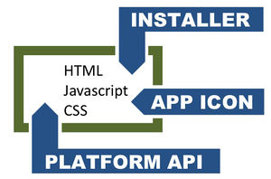
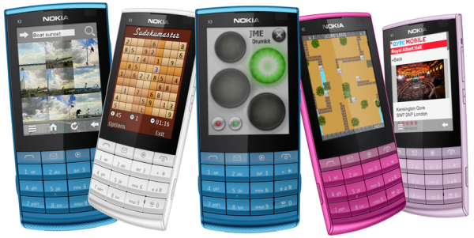
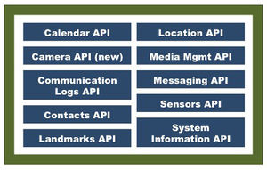
WebApps in S40: Current Status
Forum Nokia claims that the current S40 asset can support Web Apps through the Proxy Browser: “Nokia Web Tools 1.5 delivers a suite of applications that assist in the development, testing, packaging, and deployment of Series 40 web apps, including preparing them for distribution through Nokia Store. The key components of Nokia Web Tools are Web Developer Environment and Web App Simulator.”
“However, due to the Java Script being executed on the proxy server, a S40 web app requires constant server interaction, which gives a very limited 'web app' user experience”

Slide 15
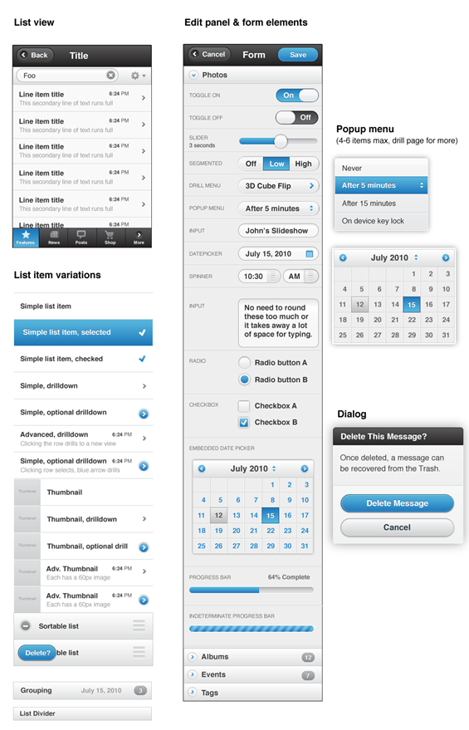

jQuery: A WebApp Framework
jQuery Mobile is a Touch-Optimized Web Framework for Smartphones & Tablets: The framework provides a unified, HTML5-based user interface system for all popular mobile device platforms, built on the rock-solid jQuery and jQuery UI foundation. Its lightweight code is built with progressive enhancement, and has a flexible, easily themeable design.
jQuery mobile supports Opera mini and Nokia proxy browser (see next slide) with a degraded UX experience. But this doesn't give the best UX experience of real web apps.
It's a good solution for devices with limited RAM (e.g. eVo 32MB). But on devices with more than 32MB ram a more natural web app experience could be provided (see next slide)

Slide 16
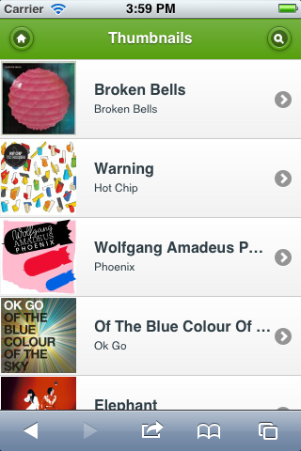




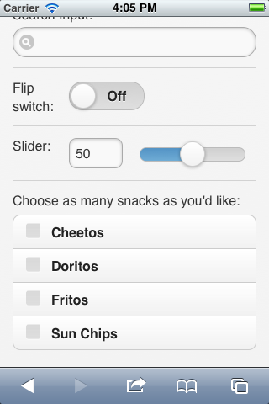
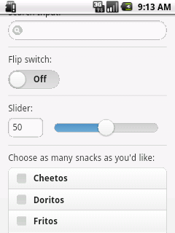
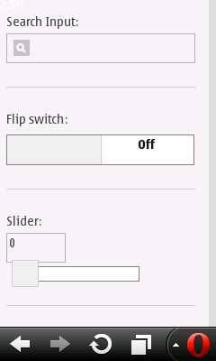
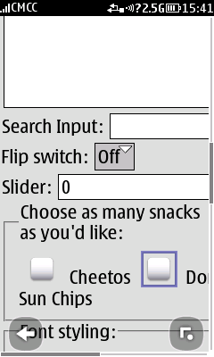
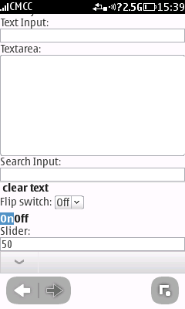
jQuery and S40: Does it work?
A: Full enhanced experience.
B: Enhanced experience
C: Basic experience
iPhone
Android QVGA
Opera Mini
Nokia OSS
Nokia Browser
A
A
B
C
C
A
A
B
C
C

Slide 17

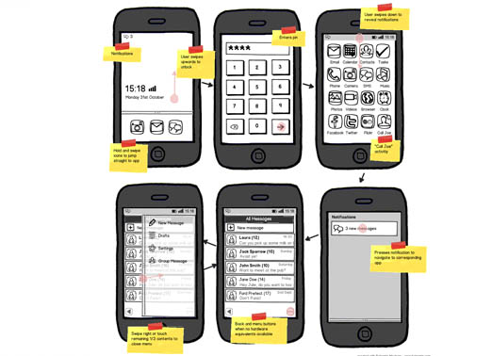
WebApps in S40NG: Objectives & Challenges
What would support for full-fledged Web Application in S40 require:
HTML5/CSS3 support (aka WebKit)
Jquery or other UI Toolkit support
Specific Mobile API (sensor, DB, …)
PhoneGap support (for 2nd phase)
What are the challenges:
Processing Power (MIPS): This is *not* seen as a big concern for HW17, since even Android can run on HW17.
Memory usage (RAM/Flash): Webapps do require more memory, but this is just a question of cost, as HW17 supports large memory.
Conclusion: Why not just try it on HW17 with more RAM and see the result.

Slide 18
HTML5/ WebKit memory usage.
The current assumption is that HTML5 (WebKit based) can run on EVO product with an additional 64MB or RAM (without somewhat “small / medium” applications), or 192MB RAM with the “full large webapps” support.
However, the conclusion is that R&D should study more how to provide a web app experience on HW17 and what is the actual amount of RAM is required for that.
Website: | RAM Usage
jquerymobile.com-lists-search.ht | 13.7MB
jquerymobile.com-lists-performan | 31.6MB
jquerymobile.com-lists-thumbnail | 14.6MB
jquerymobile.com-buttons-themes | 12.9MB
42learn.com | 13.0MB
google.com | 4.3MB
facebook.com | 4.3MB
youtube.com | 4.6MB
yahoo.com | 25.3MB
baidu.com | 5.3MB
wikipedia.org | 11.2MB
live.com | 5.5MB
blogspot.com | 7.9MB
twitter.com | 4.1MB
qq.com | 29.1MB
Measurement done by Feng Ammon based on customized Web-Kit running on Windows PC, tailored to 512KB JS Heap (instead of 16MB) and 180px screen width.
Those measurement assume the web engine to repaint for each position change, which might be quite slow on low end devices. A way to work around this is to use some tiled backing store (more memory consumption) as we do as well as iOS and Meltemi.

Slide 19
Memory Cost for HW17
“We can confidently say that enhancing from 64MB LPDDR2 RAM to 128MB LPDDR2 RAM will add 20 to 25 dollar cents while enhancing 64MB to 256MB LPDDR2 RAM will add 50 to 60 dollar cents to the total component cost. This is based on the price quotes from one supplier and “should cost” analysis by our own tools” (April 12th 2012)
The current HW17 engine configuration used for EVO1 and Titan is based on 64MB, and extending to 128MB or 256MB can be done without any hw rework (just change the memory combo IC – engine reuse block is kept the same).
Note: The official strategy after EVO1 is to reduce the memory from 64/128MB to 32/64MB of RAM/Flash for cost reduction. There is, at this point of time, no consideration for extending the memory on any product.
Draft & Early Conclusions:
The cost of providing a Level 1 Basic (but better than existing Proxy Browser) Web App experience should be $0.25.
The cost of providing on Richer Web App experience (Level 2) should be $0.6.
The best way to verify this conclusion is to prototype, (spending 3 months to do a quick port of WebKit to EVO), and see the result on the real hardware.

Slide 20


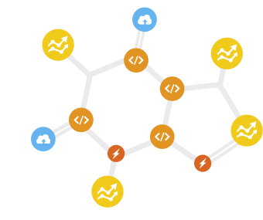
Lighter Alternatives to WebKit/HTML5
Since HTML5 is quite heavy, alternative “framework architectures” could be considered, such as for instance:
enlightenment.org (used by Samsung)
nodejs.org + librocket.com
Qt5 – Javascript and QML (Meltemi)
SX and Yappas (S40NG)
With the target to aim at lower-end engine, such as Quasar (300Mhz, 32MB RAM, …) or lower (eg Coolsand) – e.g. without any extra HW cost compared to EVO.
But, does this really make sense to use any non-standard Mobile Web solution 3 years from now? See next slide.

Slide 21
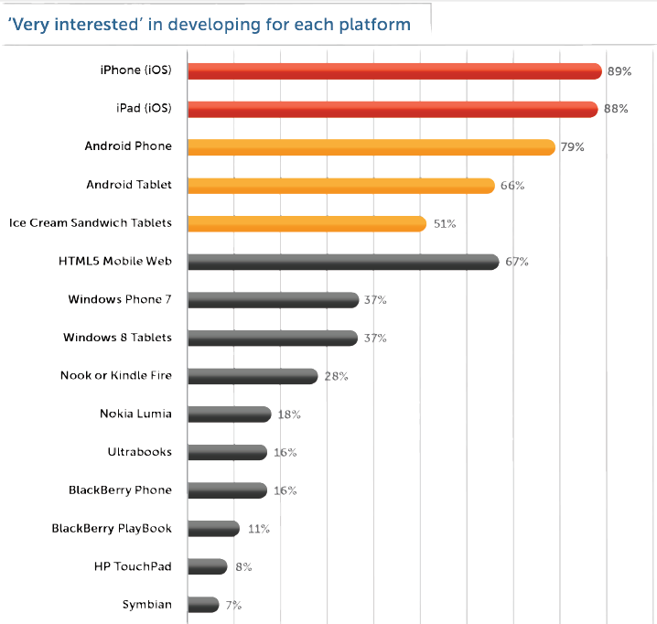
Platform and Technology and Strategy
The IDC “Q1 2012 Mobile Developer Report” show that HTML5 is favored by more than 2/3 of the mobile app developers.
Question: 3 years from now, is it still viable to have non-HTML5 compliant product in the market?
How many developers would even consider a non standard Mobile App platform? What would be the impact on the eco-system?
Then, if HTML5 goes everywhere, what are the product implications on screen size, touch, sensors, OpenGL HWA, Bearers, etc?
Appcelerator / IDC Q1 2012 Mobile Developer Report
A platform interest survey of 2,173 Appcelerator application developers from Jan 25-27, 2012

Slide 22
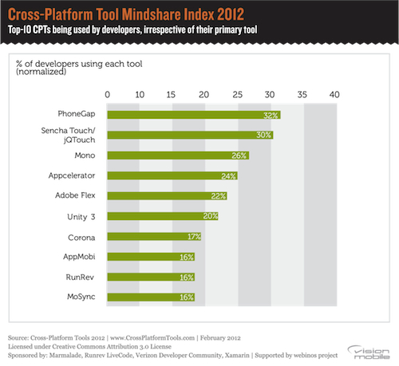
Impact on Cross-Platform Development
In the industry-first comprehensive look into cross platform mobile development by VisionMobile, HTML5 based toolkits, PhoneGap and Sencha lead developer mindshare.
Major takeaways from the study
Cross-platform tools
flatten the playing field
challenge the Apple/Google duopoly
Enable democratisation of development
Most importantly, cross platform tools will become “business as usual”, the preferred way of app development
VisionMobile Cross-Platform Developer Tools 2012
A comprehensive look into 100+ cross platform tools ands survey of 2400 developers, Feb 2012

Slide 23
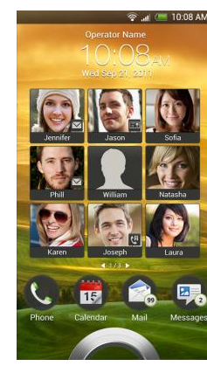
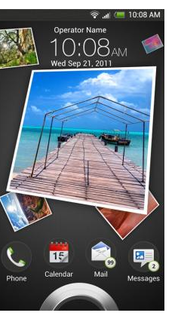
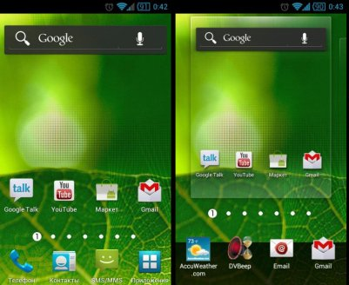

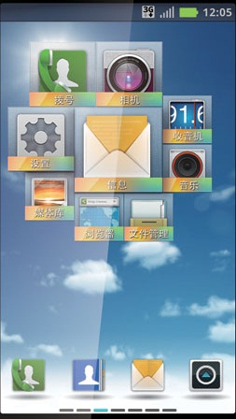
Industry Convergence?
As It seems that platforms are converging towards unified technologies (either Android or HTML5), what makes the difference?
For Android Devices: “There Isn’t One Singular Android. Skins, by Leading Android OEMs” are used to make the difference (see Aliyun, MIUI, M9, Kindle, TouchWiz, SenseUI, …)
For S40NG to use similar technologies, would it be just a competition “catch-up” game, or a way to leverage the differentiation capability?

Slide 24
What are Web Apps ?
For the purposes of this document, the term "Web application" refers to a Web page (XHTML or a variant thereof + CSS) or collection of Web pages delivered over HTTP which use server-side or client-side processing (e.g. JavaScript) to provide an "application-like" experience within a Web browser. Web applications are distinct from simple Web content (the focus of BP1) in that they include locally executable elements of interactivity and persistent state.
http://www.w3.org/TR/2010/PR-mwabp-20101021/
Web apps Level 0:
http://coremob.github.com/level-0/index.html
http://rng.io/

Slide 25
Examples of jQuery Mobile
jQuery Mobile is a popular framework for building webapps. A wide range of devices is supported from tablets to small screen devices.
The purpose is to demonstrate the graceful degradation of UI on a low-end device.
The same web app is on Opera Mini and iPhone

Slide 26
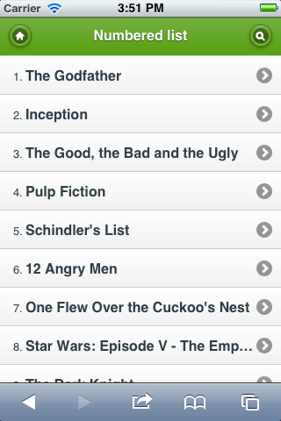
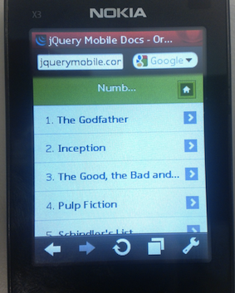
Numbered List

Slide 27
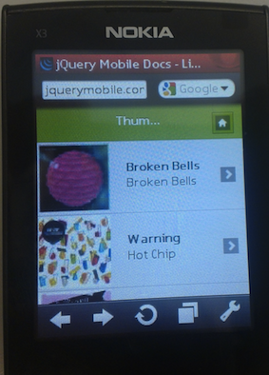
Thumbnails List

Slide 28
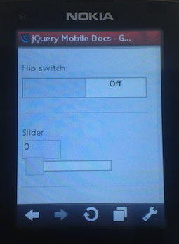
Forms

Slide 29
FirefoxOS
FirefoxOS
N9
UI
Gaia
Gecko
(web engine + hal + web api)
Layers
Runtime
Thebes
Cairo (2D)
OS + HAL
(porting layer)
Gonk
(Android-like Kernel)
Honk (plain linux, no X, not toolkits like qt)
N9 Qt (like Firefox official port)
Nitrodid (Andorid port on N9)
OpenGL ES 2
(Graphics Context)
Min: ARMv6 + 256MB RAM
Rec: Cortex A5 or ARMv7 + GPU
HW
1Ghz Cortex A8 + 1GB RAM + GPU

